Slide 1
VISIT 3D

Slide 2
Begin by reading the tutorial
VISIT/MATLAB - How to make it look better
many of the same things apply in 3D

Slide 3
Boundaries
As in 2D:
Plot vertices
Make them bigger by increasing the pixel size (use the mesh attributes to do this)

Slide 4
Vorticity - 3D View
add contour of omega_magnitude
modify the attributes
change the minimum and maximum vorticity as in 2D
modify N levels somewhere between 5 and 10
choose single for contour colors
modify the color - I chose blue
modify the opacity between 10% and 15%
zoom in and modify the camera angle

Slide 5
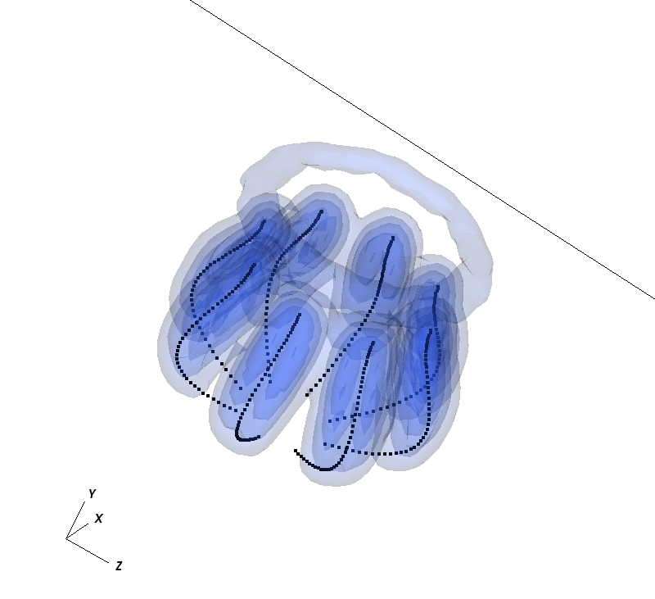
Vorticity - 3D view
Example:
(this simulation is on a very coarse grid)

Slide 6
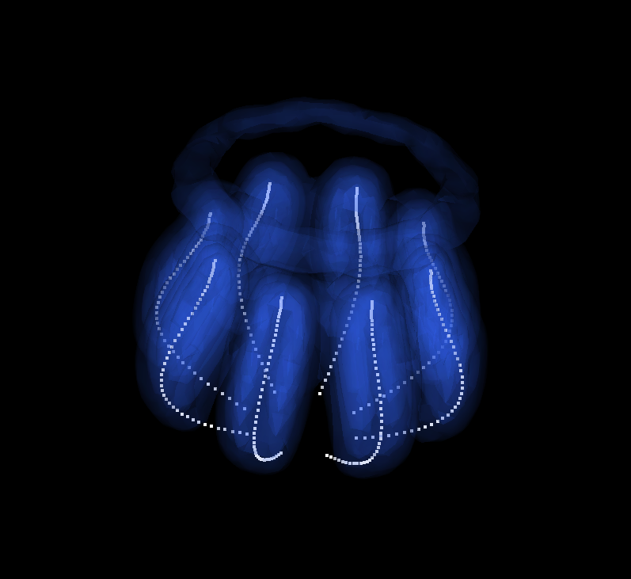
Vorticity - 3D view
Example: Playing with the colors (controls -> annotation) can modify things a lot

Slide 7
Adding velocity vectors on a slice
add vector of U
modify the attributes
location: change the number of vectors (fixed number = 4000) and place them uniformly
form: change form quality to high
rendering: change color and set min and max values based on data

Slide 8
to make a slice
deselect apply operators to all plots and apply subset selections to all plots in the main window
highlight the added Vector - U
choose operator attributes -> selection -> slicing -> slice
slice operator attributes -> choose the slice you want

Slide 9
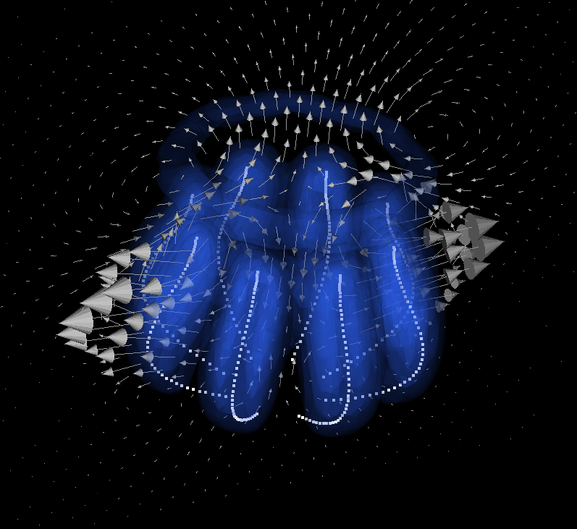
Adding velocity vectors on a slice
Example:

Slide 10
Other things on slices
In similar ways you can add other properties on slices - here is an example of looking at the vorticity on the same slice as the velocity field
Once again you just apply the operator attribute to the desired field (here I also modified some of the plot attributes of the vorticity field.)

Slide 11
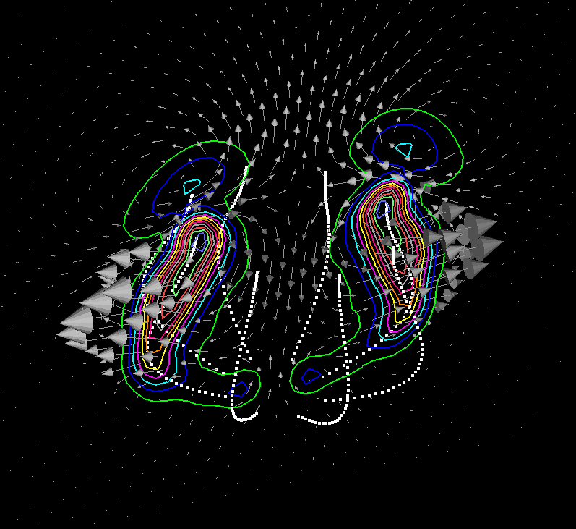
Other things on slices
Example of vorticity contours on a slice:

